Slide 1
"Born To Run"
An inquiry-based lesson to teach evolution
Tricia Radojcic, Ph.D.
Chaparral High School, Murrieta, California
and
Theodore Garland, Jr., Ph.D.
University of California, Riverside
Supported by National Science Foundation,
American Physiological Society,
University of California, Riverside

Slide 2
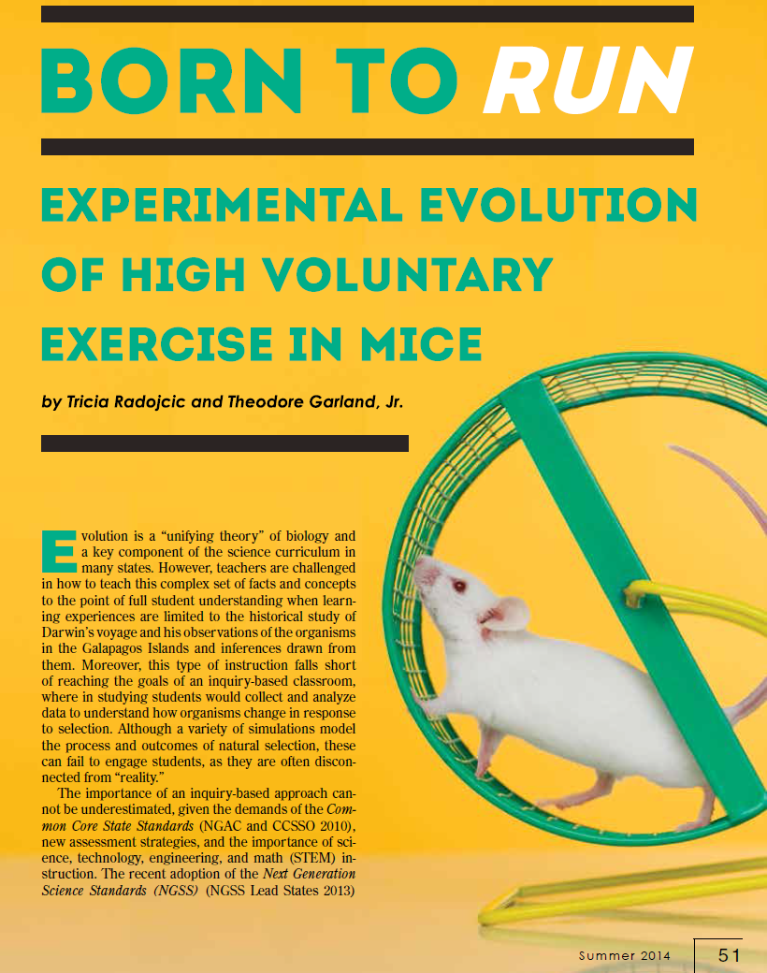
"Born To Run"
An inquiry-based lesson to teach evolution
http://www.indiana.edu/~ensiweb/lessons/BornToRun.html
Radojcic, T., and T. Garland, Jr.
2014. Born to run: Experimental
evolution of high voluntary
exercise in mice.
Science Scope 37:51-60.
Originally developed for
middle school, but easily
scaled up to high school
and college
Notes:
Open inquiry requires flexibility in the samples so that they can accommodate a variety of questions

Slide 3
"Born To Run"
We will post this presentation here:
http://www.biology.ucr.edu/people/faculty/Garland/Artificial_Selection_Lab_2014_NSTA_6.pptx
Feel free to use it, edit it, share it!
Notes:
Open inquiry requires flexibility in the samples so that they can accommodate a variety of questions
3

Slide 4
Overview of Today's Session
Strategies for teaching evolution
Experimental evolution
Artificial selection
An inquiry-based lab
  Developing questions/hypotheses
  Data collection
  Data analysis
  Writing conclusions and relations to the Common Core
Notes:
Open inquiry requires flexibility in the samples so that they can accommodate a variety of questions
4

Slide 5
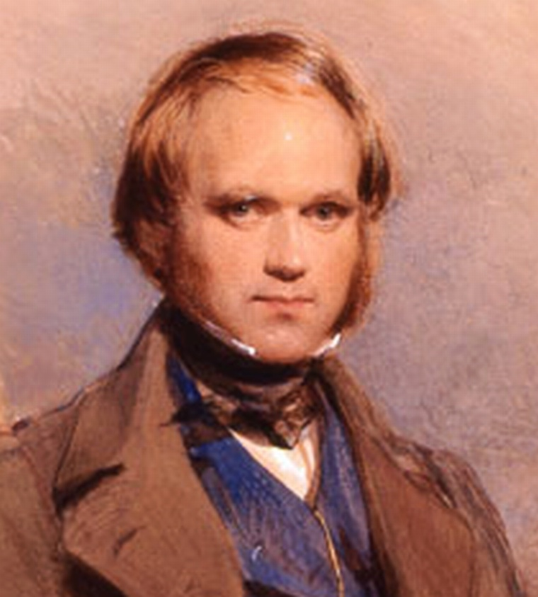
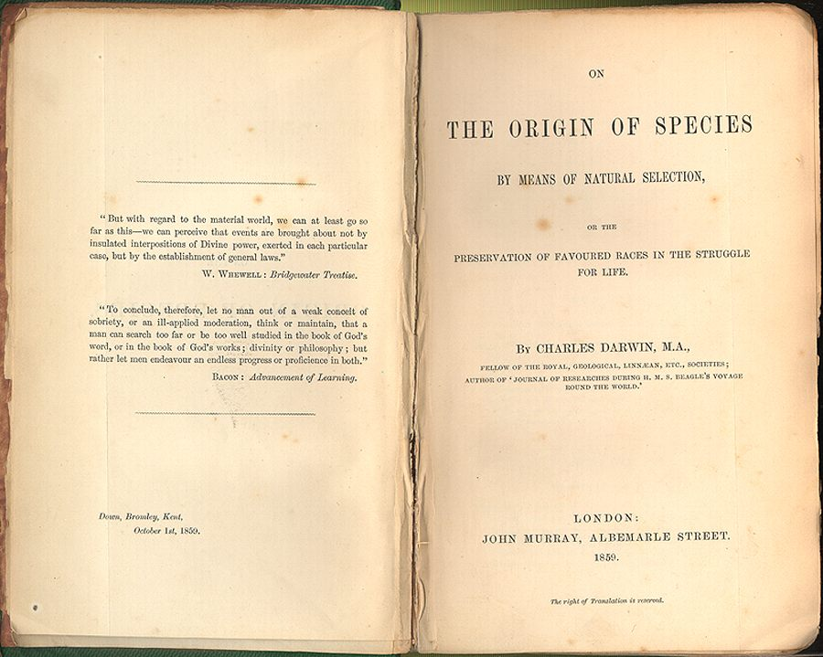
Teaching Evolution
Traditionally text based
  Definitions & examples
  Historical: reviewing published results

Slide 6
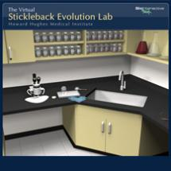
Teaching Evolution
Modeling
  Constructing hypothetical “organisms” and “environments” that cause selection
  Computer simulations
http://www.hhmi.org/biointeractive/stickleback-evolution-virtual-lab

Slide 7
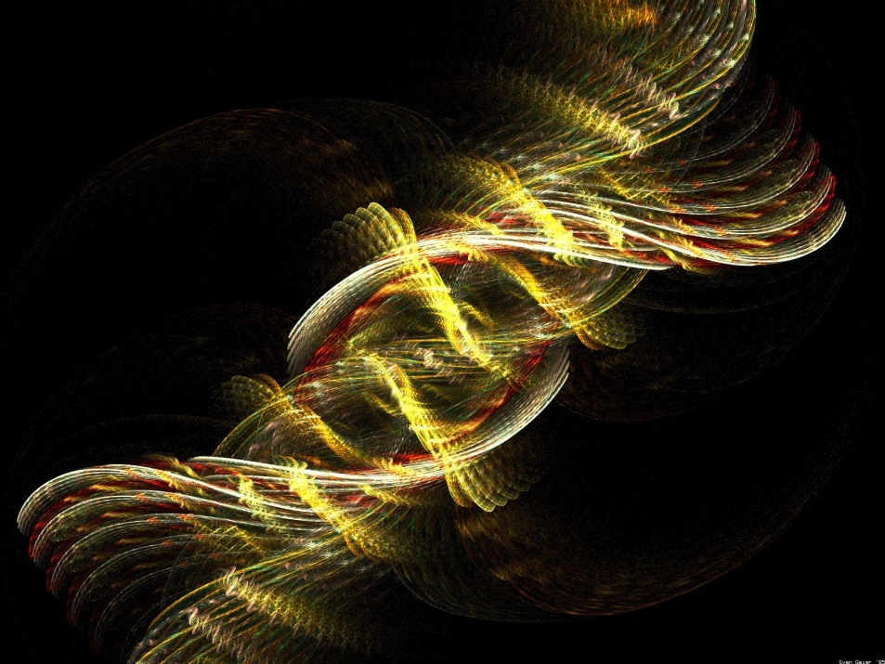
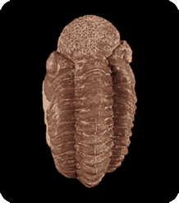
Teaching Evolution
Sample analysis
  Fossil evidence
  DNA evidence
http://www.ucmp.berkeley.edu/education/explorations/tours/stories/middle/intro.html

Slide 8
Explorations some existing resources
Cladistics is a Zip…Baggie
http://www.indiana.edu/~ensiweb/lessons/clad.bag.html
Natural Selection of Stick Worms
http://www.indiana.edu/~ensiweb/lessons/ns.st.wm.html
A peek at the past: Fossil patterns: Gradualism vs. Punctuated Equilibria
http://www.indiana.edu/~ensiweb/lessons/peek.html
Nature at Work: Prentice Hall 2008 California Focus on Life Science pages 232-233
The chips are down: A natural selection simulation
http://www.indiana.edu/~ensiweb/lessons/ns.chips.html
An Origin of A Species: PBS interactive site
http://www.pbs.org/wgbh/evolution/darwin/origin/index.html
Stories from the Fossil Record: UCMP Interactive Website
http://www.ucmp.berkeley.edu/education/explorations/tours/stories/middle/intro.html

Slide 9
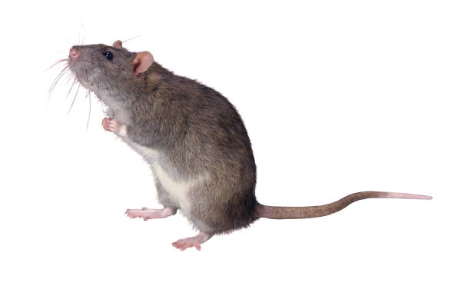
Evolution and Inquiry in the Classroom?
Evolution is not a topic which lends itself to experimentation and inquiry in a classroom.

Slide 10
Born to Run
Affords Students Opportunities to:
Design and perform their own investigations
Collect and analyze real data
Participate in real science with a research lab
Participate in crowd-sourcing the results of their investigations

Slide 11
Connections!
How will inquiry help me???
Connecting to Common Core
  Math – data collection, graphing
  Language arts – collecting evidence to support a claim
Supporting Next Generation Science Standards
  Opportunity to “practice” real-world activities to learn the content

Slide 12
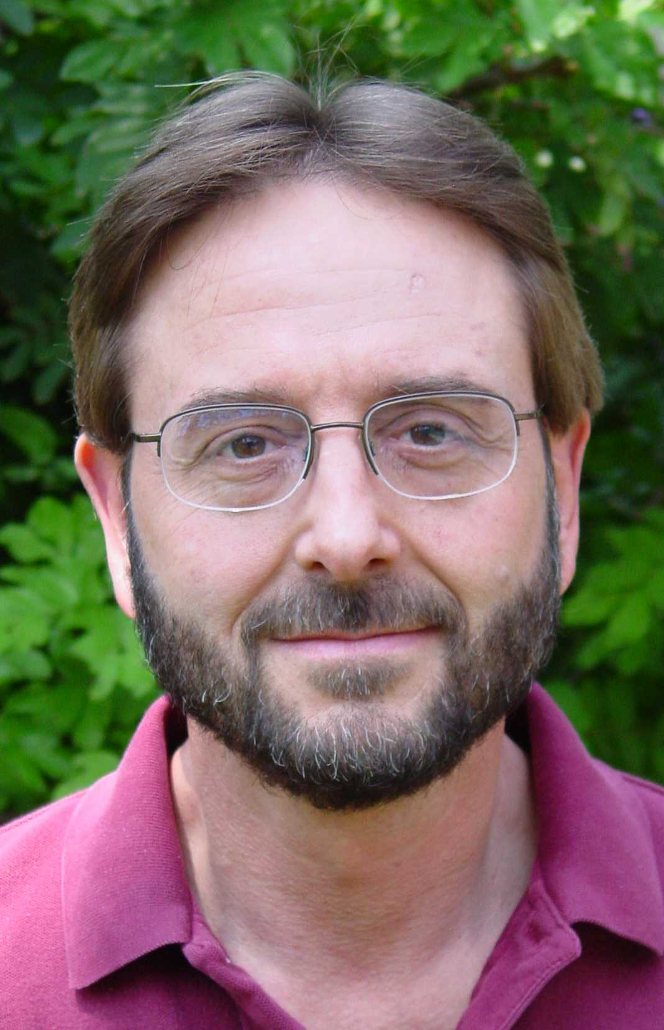
Artificial selection for increased voluntary wheel running in mice
Dr. Theodore Garland, Jr.
University of California,
Riverside
NSF and APS
More than 130
publications on these
mice, all available as
PDF files at his website:
you or your students can
access them for free

Slide 13

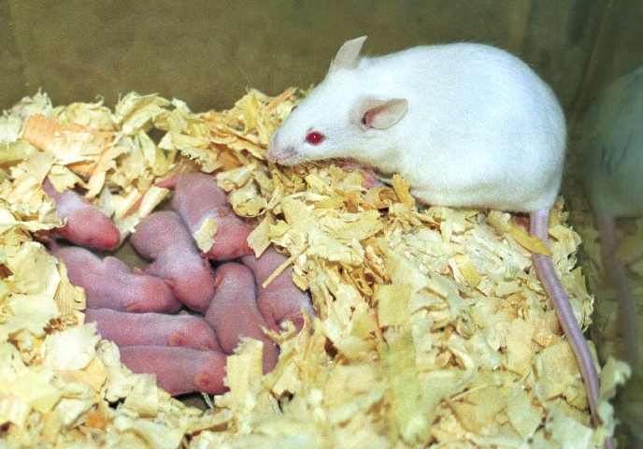
"…research in which populations are studied across multiple generations under defined and reproducible conditions, whether in the laboratory
or in nature."
Notes:
Ted’s part – feel free to add or delete from the following slides – I added those that I thought were important

Slide 14
Experimental Evolution Addresses Common Misconceptions:
Evolution can occur rapidly
  observable within <10 generations
Evolution is amenable to experimental study
  not only an historical science
Evolution is not "just a theory"
  hard to deny what you can directly observe yourself
14

Slide 15
Types of Experimental Evolution
In field:
Population responds to an alteration
Population introduced to new environment
In lab:
Alter environment and observe the population across generations
Artificial selection – selecting and breeding for a specific trait

Slide 16
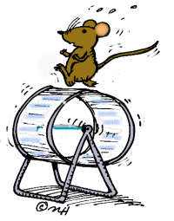
Why Select on Wheel-Running?
potentially physiologically taxing
(likely to cause some physiological evolution)
individual differences are highly
repeatable (consistent)
(easy to choose the best runners)
partly inherited
(know it will respond to selection)
easy to automate measurement
important component of energy expenditure and a regulator of body composition (fat, muscle)
analogous to human voluntary exercise?
(e.g., Eikelboom, R. 1999. Human parallel to voluntary wheel running: exercise. Animal Behaviour 57:F11-F12.)
http://school.discovery.com/clipart/clip/ani-mouse.html
Notes:
Eikelboom, R. 1999. Human parallel to voluntary wheel running: exercise. Animal Behaviour 57:F11-F12.

Slide 17
Experimental Design
Star ting (Base) Population in 1993:
112 male & 112 female mice from an
outbred population (Hsd:ICR strain)
Design:
8 lines: 4 bred for High Running (HR)
4 non-selected Control (C)
10 mating pairs in each (lit ter size ~10)
Within-family selection
Selection Criterion:
Wheel revolutions on days 5 + 6

Slide 18
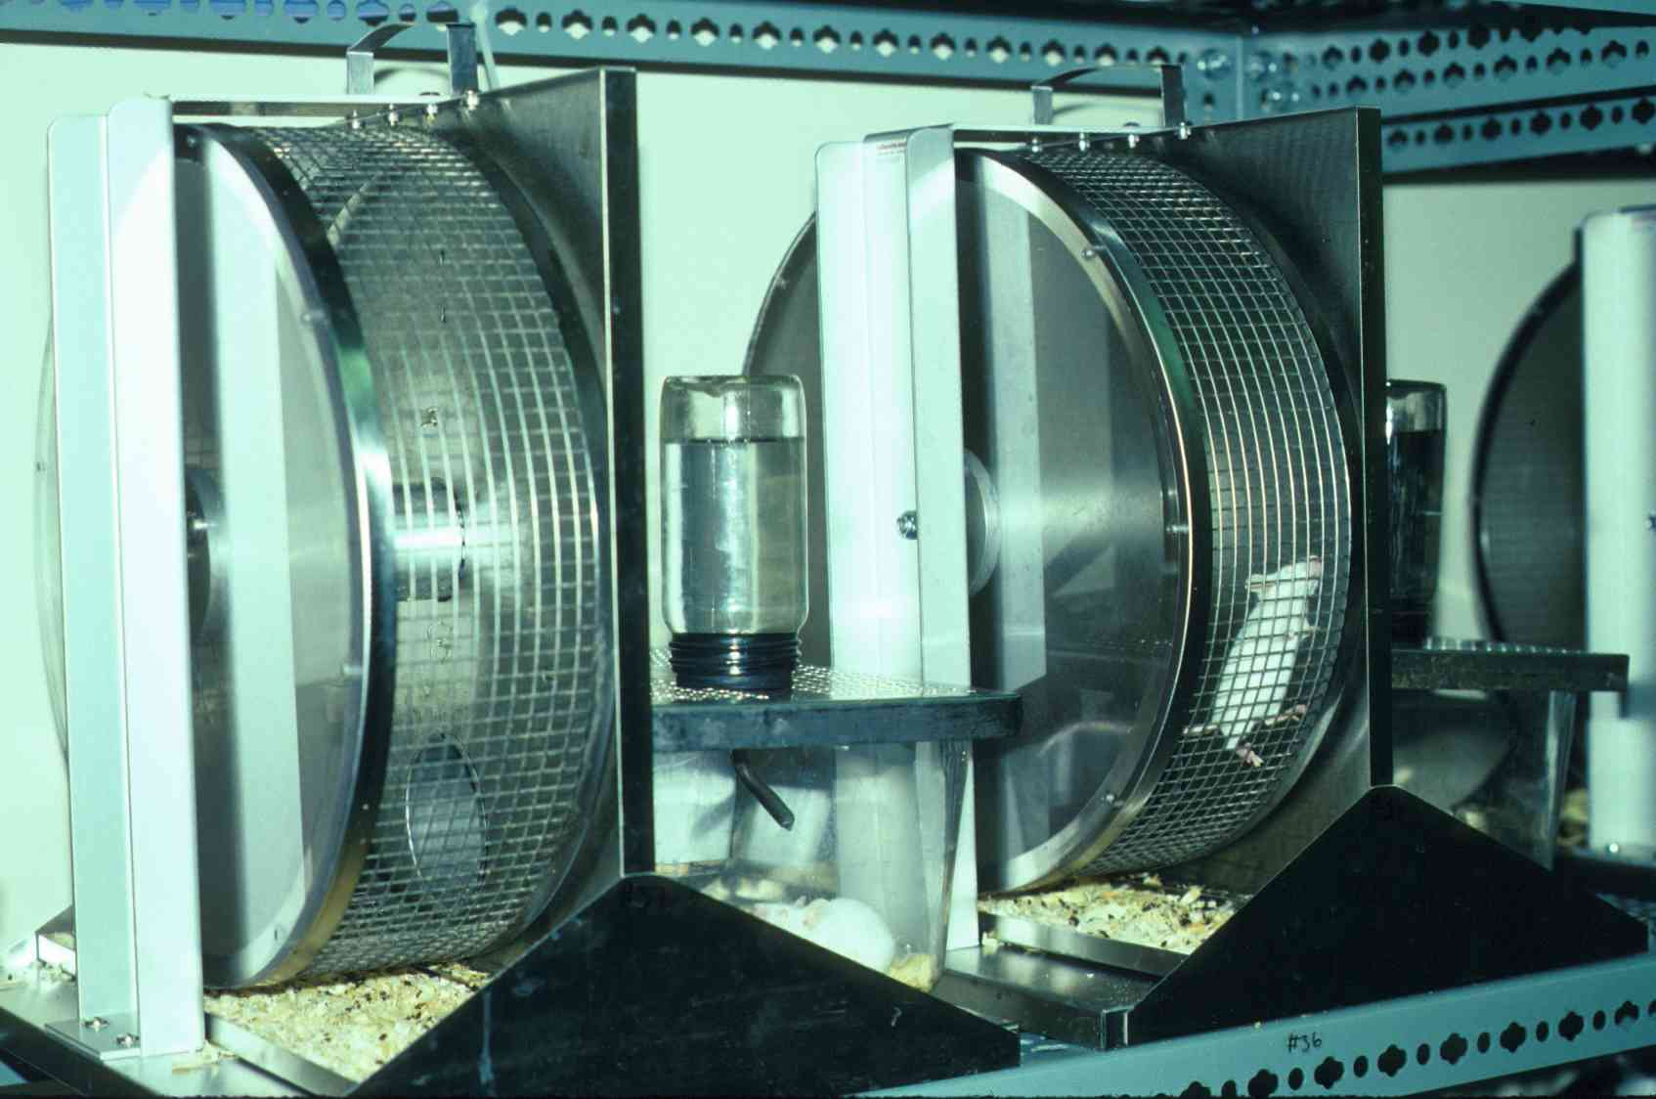
Wheels are Attached to Standard Housing Cages
Notes:
MusOnWheel-EQ-30.jpg
= scanned slide at Excellent Quality, then
= 30% save in Microsoft Photo Editor

Slide 19
Revolutions/Day on days 5 + 6
Wheel Circum-
ference = 1.12 m
Selected
Selected females run 3X more than control females
Control
0 5 10 15 20 25 30 35 40 45 50
Generation
14FRUN56.DSF
Notes:
27 Jan 2010:
Each generation takes three months--- 15 years or so this experient has been going on.
Gen 60. 4generations a year, 15 years .
Perspective: a human generation takes ~ 20years (versus 3 months for mice!) 60 human generations = 60 x 20= 1,200 years!!!
2 March 2001
Data are exported from Axum for DOS file named 14FRUN56.DSF
The ASCII file named .DOC was then opened in Excel.
From the Excel file, it was pasted into PowerPoint.

Slide 20
Revolutions/Day on days 5 + 6
Wheel Circum-
ference = 1.12 m
Males always tend to run less than females, but the differences between selected and control are the same as in females.
Selected
Control
0 5 10 15 20 25 30 35 40 45 50
Generation
14MRUN56.DSF
Notes:
Discuss generational differences and indicate that photos are from g12
2 March 2001
Data are exported from Axum for DOS file named 14MRUN56.DSF
The ASCII file named .DOC was then opened in Excel.
From the Excel file, it was pasted into PowerPoint.

Slide 21
Show movie that accompanies:
Girard, I., M. W. McAleer, J. S. Rhodes, and T. Garland, Jr. 2001. Selection for high voluntary wheel running increases intermittency in house mice (Mus domesticus).
Journal of Experimental Biology 204:4311-4320.
http://www.youtube.com/watch?v=RuqhC7g_XP0

Slide 22
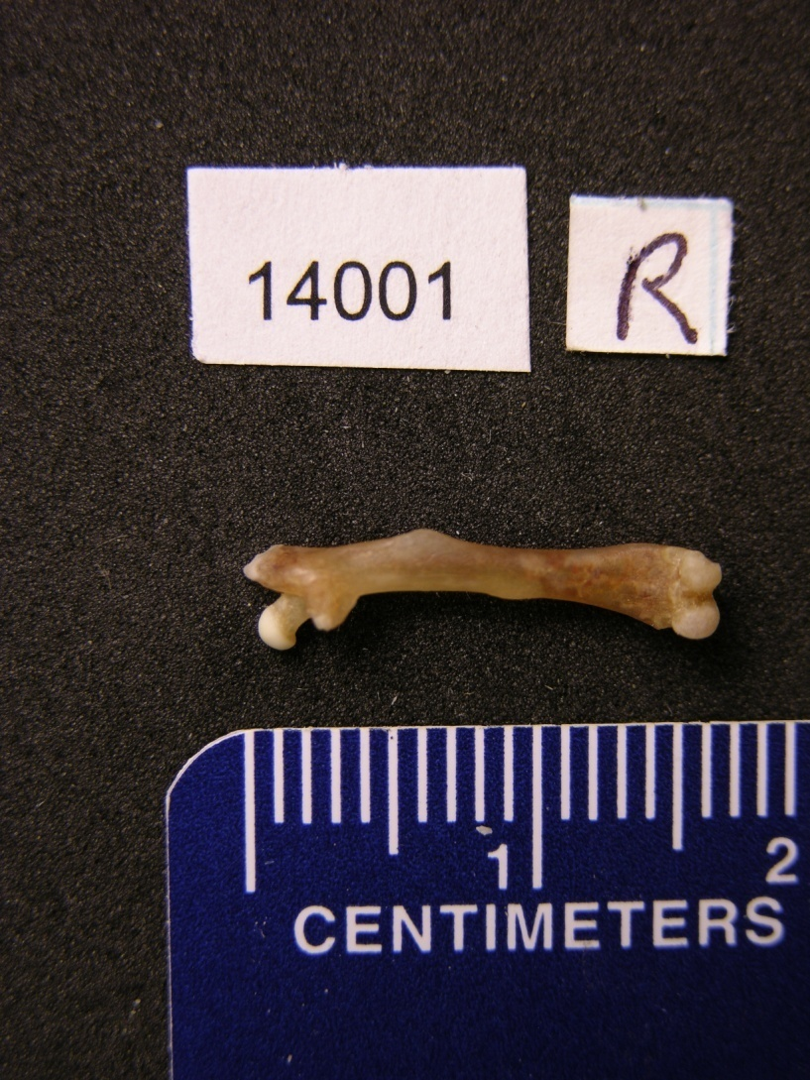
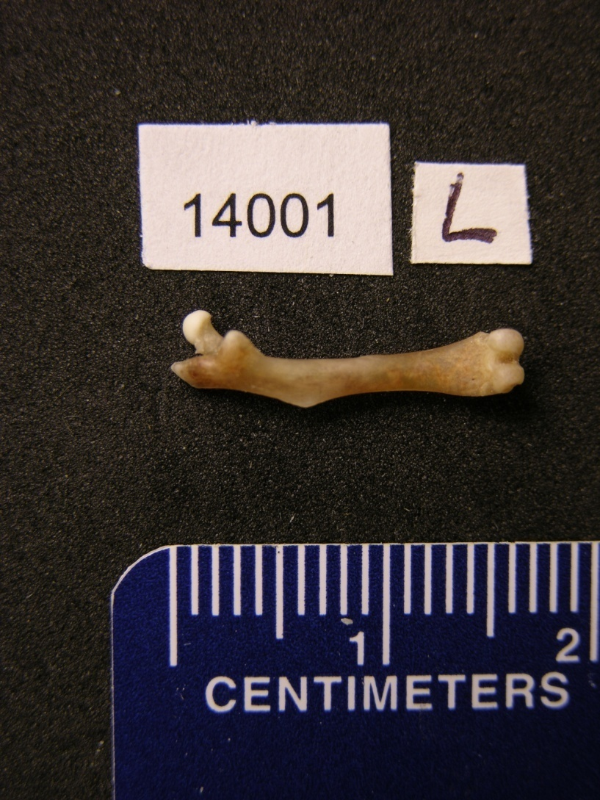
We provide photographs of actual research specimens used to publish scientific papers: this is real science!

Slide 23
"Born To Run"
An inquiry-based lesson to teach evolution
… makes use of those photos …
… after first introducing and motivating students to the subject material …
Notes:
Open inquiry requires flexibility in the samples so that they can accommodate a variety of questions
23

Slide 24
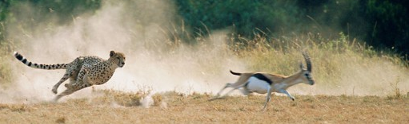
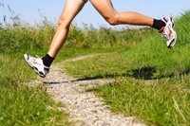
In general, how would the legs of a good runner be different from those of "regular" animals?
True for other
good runners?
  Cat
True for extinct
animals?
  T Rex
True for human beings?
  Human
What about the bones of
good runners?
  Human skeleton
http://www.dublinphysio.com/blog
Notes:
Begins to guide students to connect what they know about runners with mice used in art sel experiment

Slide 25
Pushing students to think:
Do you expect the legs to be:
Longer
Stronger
Lighter
Flexible
Muscular
How would this affect/show on the femur?
Notes:
Leg length is easy but students need guidance to devise a measurement strategy for investigating leg “strength” and “flexibility”.
They need help to push their thinking and take on more challenging approaches.
Opportunities for extending knowledge: students can research muscle attachments etc.

Slide 26
Collecting Data from Photos
Mouse ID number
  Provided in the Excel file:
    Selected or Control
    Sex
    Body mass at death
Right or Left femur?
Scale bar
  Note that this femur is
  ~16 mm in length

Slide 27
Your Turn!
Discuss questions/hypothesespredictions you could address/test
by measuring photographs of femurs from these athletic mice.
Notes:
Participants discuss and share

Slide 28
Born to Run & the Scientific Method
Observation: Good runners usually have
long & strong legs, among other characteristics.
Question: How would the legs of mice artificially selected for high levels of wheel running differ from those of control mice?
Hypothesis: They should differ in ways that would improve running ability (e.g., be longer, stronger, lighter).
Prediction: The femur bones of selected mice will be [longer? thicker? etc.?].
Notes:
The Scientific Method:
Observation
Question
Hypothesis
Prediction
Gather data to test predictions

Slide 29
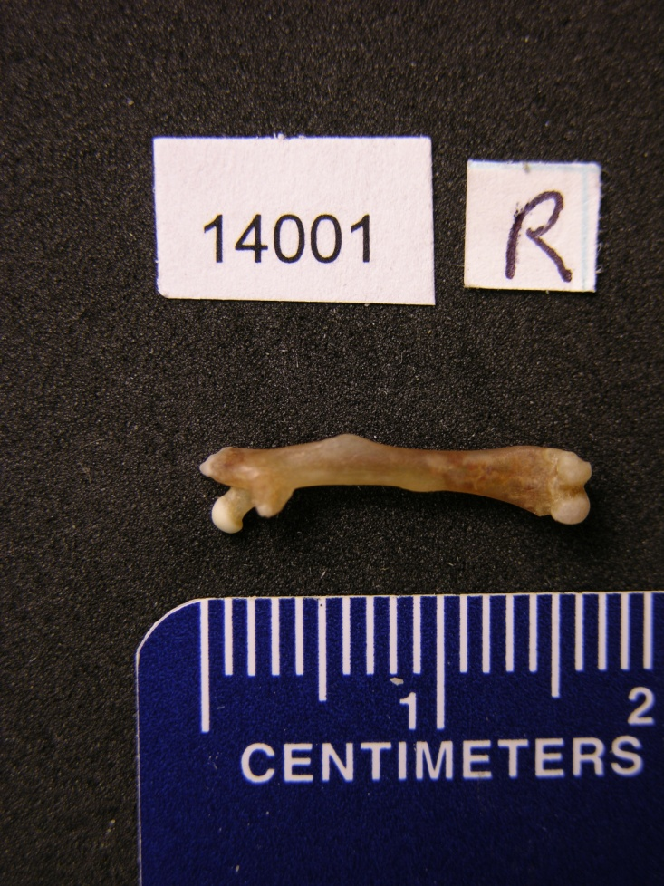
How Will You Measure?
Planning
  Bones have features which vary by individual
Practice
  Ensure that each measurement is consistent
Compare
  Two measurements of the same photograph
  (by different students)

Slide 30
Measurement options
Direct measurement of photographs:
  From a hardcopy print
  By holding a ruler to the computer monitor
    Math connection: Using the scale bar
    Common core shift: Rigor
Automated measurement using Image J
  Technology connection
Notes:
Reference for common core shifts:
http://www.achievethecore.org/math-common-core/professional-development/introduction-math-shifts
Linked from CDE website: http://www.cde.ca.gov/re/cc/ccssupdate18dec2012.asp

Slide 31
Direct Measurement of Photographs
Mouse number | Leg (cm) | Scale factor | Actual (cm)

Slide 32

Automated Measurement using ImageJ
Select File – Open: Click on the first image
Select Line tool on the tool bar
Draw a line on the ruler that is 15 mm (1.5 cm)
On menu bar: Select analyze – set scale
Draw a line on the femur
On the menu bar: Select analyze - measurement
Notes:
Give handouts of directions

Slide 33
Accessing Biological "Specimens"
The femur photographs are contained in online folders organized by line type & sex:
  G12_Control_Female_Femora (4 lines)
  G12_Control_Male_Femora (4 lines)
  G12_Selected_Female_Femora (4 lines)
  G12_Selected_Male_Femora (4 lines)
Each mouse is represented by two photos,
1 of the Left femur and 1 of the Right
The downloadable spreadsheet (Excel file) includes data on body mass of each mouse
Notes:
Allows for students to investigate factors such as sex and leg symmetry
33

Slide 34
Many questions can be addressed, various points made
Are two measurements of the same bone dimension reproducible?
  Plot measure 1 vs. measure 2
  How do you deal with discrepancies?
      Remeasure?
      Throw one out?
Key Point Measurements form the empirical basis for testing scientific predictions - they must be precise & accurate.
Notes:
34

Slide 35
Many questions can be addressed, various points made
Using the means (averages) of femur measurements, do Selected and Control mice differ?
  Make a bar graph
  Make a histogram
Key Point This is probably at the heart of the main predictions you made and can include length, width, femoral head size, etc.
Notes:
35

Slide 36
Many questions can be addressed, various points made
Using the means (averages) of the replicate measurements, are the left and right femurs exactly the same length?
  Plot left leg measure vs. right leg measure
  Is there any directional asymmetry?
  (see Garland & Freeman 2005)
Key Point Many organisms are bilaterally symmetrical, but not perfectly so. Asymmetry could affect function.
36
Notes:
36

Slide 37
Many questions can be addressed, various points made
Using the means (averages) of left and right femur measurements, do males and females differ?
  Make a bar graph
  Make a histogram
Key Point Most organisms have some degree of sexual dimorphism. It needs to be considered when studying them.
37
Notes:
37

Slide 38
Many questions can be addressed, various points made
If you provide students with the data on body mass …
  Do Selected and Control mice differ in average body mass?
  Do males and females differ in average body mass?
  Do you need to account for variation in body mass when comparing femur dimensions?
    Yes, you do! Make a scatterplot
Key Point Body size affects everything. It needs to be considered when analyzing data.
Notes:
38

Slide 39
Many questions can be addressed, various points made
All of the analyses can be separated by line.
  Do the lines differ?
    Yes, they do for some traits!
Key Point The lines are the experimental units and they must be replicated to allow strong inferences concerning the effect of the selection treatment. Genetic drift can cause any two lines to differ. A single Selected and Control line would be an unreplicated experiment.
39
Notes:
39

Slide 40
Data Recording/Sharing Options:
On paper:
  downloadable student handout
  make your own data sheet
  lab notebook
Electronic spreadsheet (Excel, Google Drive)
Google form for online submission that enters automatically into a Google spreadsheet
  students are sent a link to the form that allows
  entry of one of many measurements

Slide 41
Data Recording/Sharing with a
Downloadable Student Handout
Sample number | Selected Measurement (cm) | Sample number | Control Measurement (cm)
Averages
 | Average Measurement (mm) | Total number of femurs measured
Selected
Control

Slide 42
Data Recording on a
Downloadable Spreadsheet
(Excel file, can convert to Google Drive)
Includes information about:
  Line type (0 = Control, 1 = Selected)
  Line (1,2,4,5 = Control, 3,6,7,8 = Selected)
  Sex (0 = Female, 1 = Male)
  Body mass (grams)
  Measurements of R & L femur lengths (mm)
  taken by calipers directly from the bones and used to publish Garland
  & Freeman (2005) - you may/may not want to give this to students
Can be used to make graphs

Slide 43
Sample of Downloadable Spreadsheet
(-9 indicates no data available)
MouseID | Linetype | Line | Sex | KMass | RFML | LFML
14001 | 0 | 1 | 0 | 37.68 | 15.86 | 15.77
14159 | 0 | 1 | 0 | -9.00 | -9.00 | -9.00
14201 | 0 | 1 | 0 | -9.00 | -9.00 | -9.00
14202 | 0 | 1 | 0 | 34.60 | 16.13 | 15.82
14278 | 0 | 1 | 0 | -9.00 | -9.00 | -9.00
14279 | 0 | 1 | 0 | 40.48 | 16.34 | 16.18
14315 | 0 | 1 | 0 | 34.99 | 15.96 | 15.95
14377 | 0 | 1 | 0 | 38.90 | 16.30 | 16.33
14408 | 0 | 1 | 0 | -9.00 | -9.00 | -9.00
14422 | 0 | 1 | 0 | -9.00 | -9.00 | -9.00
14587 | 0 | 1 | 0 | 37.22 | 16.54 | 16.12
14588 | 0 | 1 | 0 | 35.65 | -9.00 | -9.00
14004 | 0 | 1 | 1 | 39.17 | 15.16 | 15.00
14160 | 0 | 1 | 1 | 42.28 | 14.83 | 14.87
14204 | 0 | 1 | 1 | 45.51 | 16.10 | 16.06
14277 | 0 | 1 | 1 | 46.07 | 15.16 | 15.14
14314 | 0 | 1 | 1 | 54.04 | 15.26 | 14.92
14375 | 0 | 1 | 1 | 49.12 | 15.55 | 15.53
14407 | 0 | 1 | 1 | 42.64 | 15.57 | 15.32
14425 | 0 | 1 | 1 | 47.71 | 15.40 | 15.34
14584 | 0 | 1 | 1 | 41.05 | 15.45 | 15.18
14591 | 0 | 1 | 1 | 42.09 | 15.51 | 15.16

Slide 44
Data Recording/Sharing with a
Google Form
Create your own Google form
Send link (URL) to students
They enter their data individually and then click "submit"
Data go automatically into a Google spreadsheet
  Only you can see it or share with students
  Common core shift: Collaboration
Notes:
Reference for common core shifts:
http://www.achievethecore.org/math-common-core/professional-development/introduction-math-shifts
Linked from CDE website: http://www.cde.ca.gov/re/cc/ccssupdate18dec2012.asp
44

Slide 45
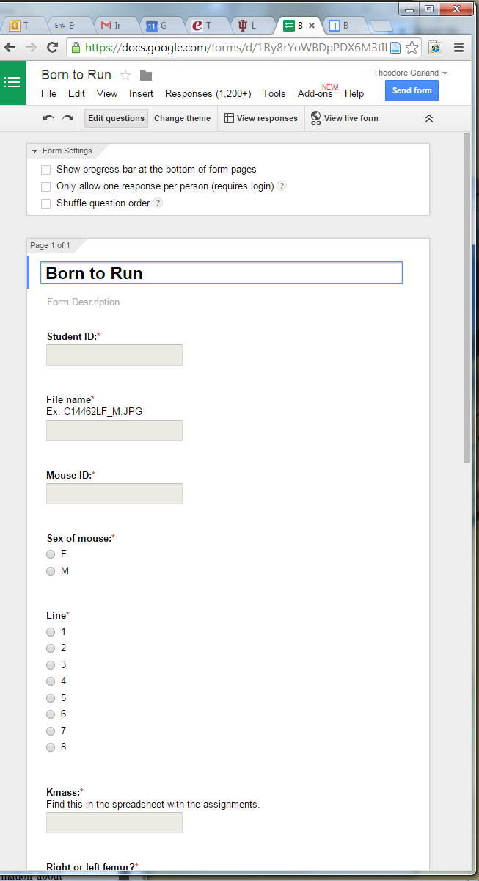
Screen Shot of a Google Form
(you can customize this any way you choose)

Slide 46
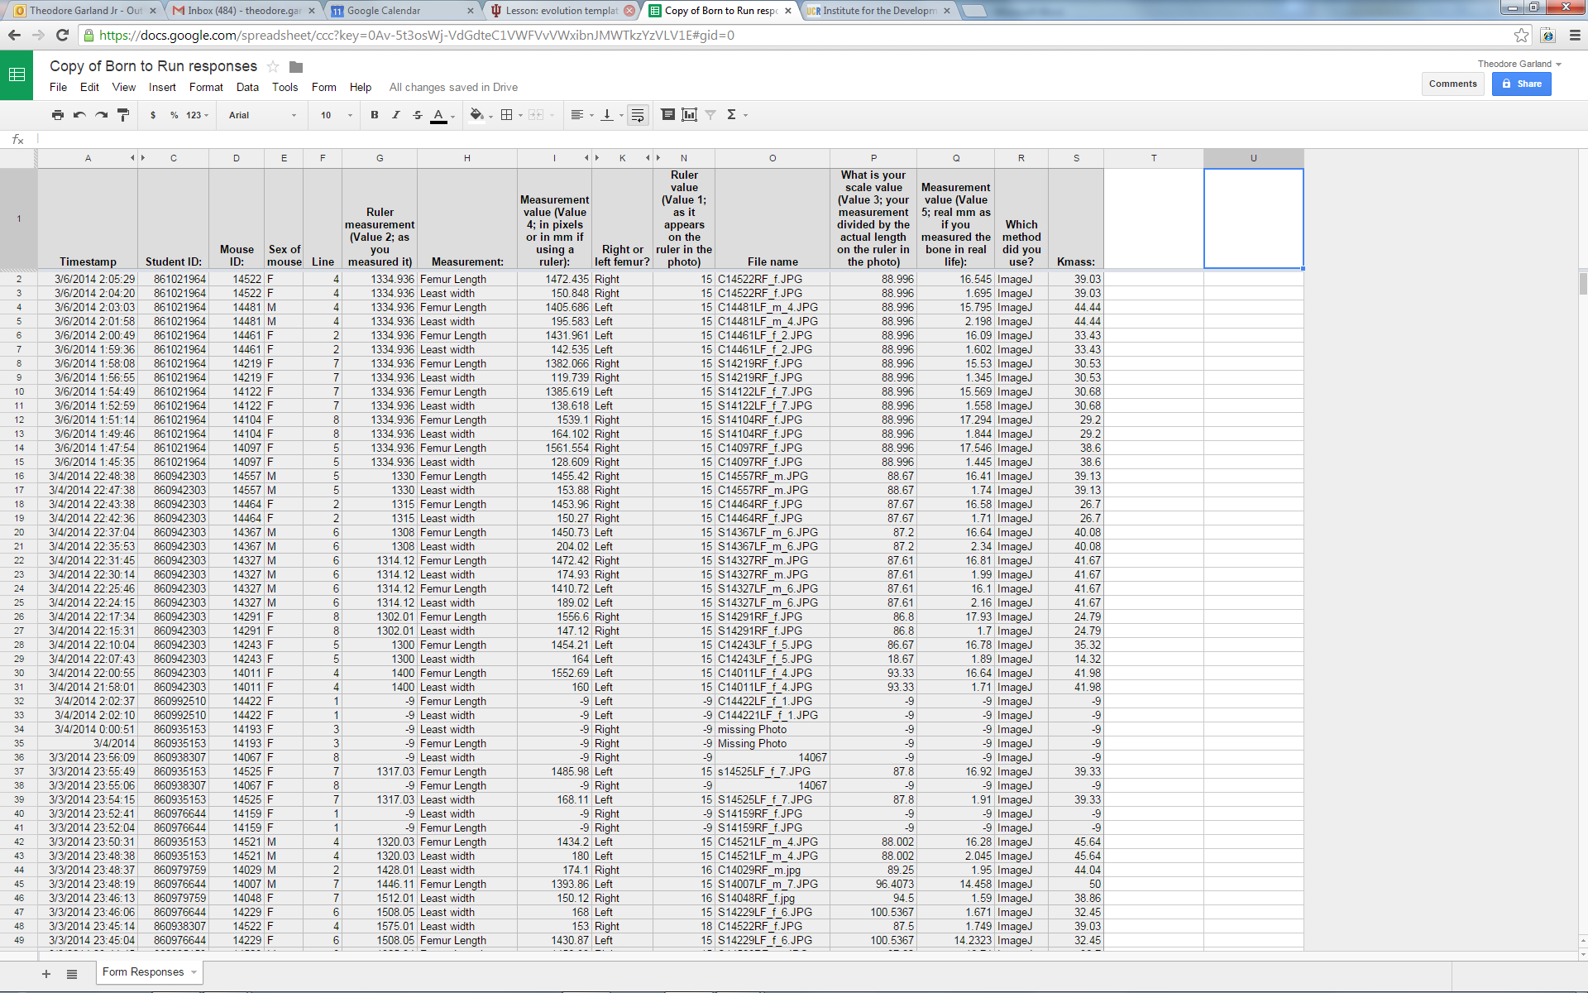
Data Submitted through a Google Form

Slide 47
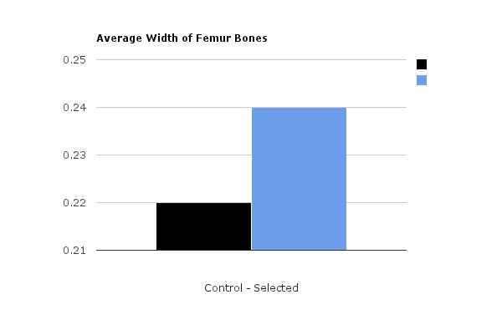
Data Analysis Options
Bar graph of average femur dimensions
But what about possible sex differences?
Notes:
I used this for an opportunity for cross curricular application – students were taught by our computer teacher how to use Excel to graph
47

Slide 48
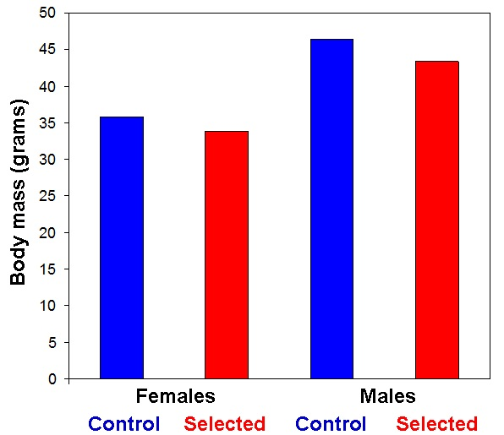
Data Analysis Options
Bar graph of average body masses
(provided in the downloadable Excel file)
Notes:
I used this for an opportunity for cross curricular application – students were taught by our computer teacher how to use Excel to graph

Slide 49
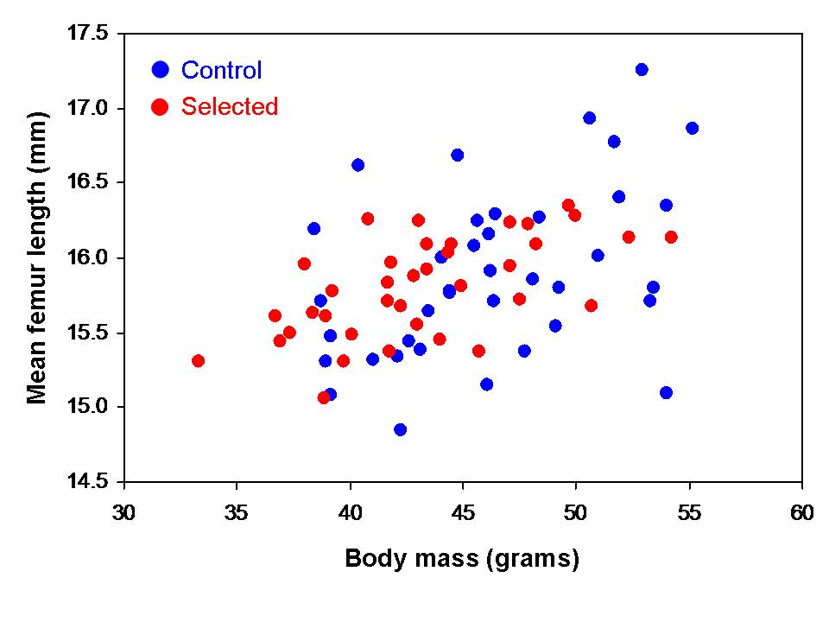
Data Analysis Options
Scatter plot to factor in body mass
Also need to separate by sex
Notes:
I used this for an opportunity for cross curricular application – students were taught by our computer teacher how to use excel to graph
49

Slide 50
Data Analysis Options
Depending on the level of your students, it may make sense to give all of them a standardized "Results" section after you have reached a consensus in class.
  If they are confused about the basic results, how can they write a conclusion, etc.?
  So, you may want to finalize the graphs, tables, and a few sentences explaining the Results while referring to the individual graphs & tables.
They add Introduction, Methods, Conclusions, etc.
Notes:
I used this for an opportunity for cross curricular application – students were taught by our computer teacher how to use Excel to graph
50

Slide 51
Born to Run is easily "scalable" depending on the level of your students, the number of curricular connections you want to make, and the amount of time you have to devote.
Go ahead, run with it!
Notes:
51

Slide 52
Helping Students Reach Conclusions
Supporting ELA Common Core
Explain your results. What effect did selective breeding for the trait of wheel running have on your measurements?
Explain how the average femur measurements for selected and control mice support your hypothesis. Be sure to restate the averages you obtained.
Was your hypothesis supported or not?
What parts of your methods might have resulted in inaccuracies?
Suggest further questions to address.
Notes:
ELA shifts: caution – shifts refer to informational text and not writing
http://www.achievethecore.org/ela-literacy-common-core/shifts-practice/

Slide 53
Middle-school Student Conclusions
"I hypothesized that the selected mice would have longer legs, as they have been shown to run faster on wheels. However, my results suggest otherwise."
"There are several problems… For example, I may have misjudged the distance ... when measuring the femurs."
"In addition, selected mice were smaller in body mass, and that may have caused them to have shorter legs."

Slide 54
tradojcic@tvusd.k12.ca.us theodore.garland@ucr.edu
Our Contact Information
We would love to hear from you about your experiences, extensions, further applications, modifications, etc.
We will post this presentation here:
http://www.biology.ucr.edu/people/faculty/Garland/Artificial_Selection_Lab_2014_NSTA_6.pptx
Feel free to use it, edit it, share it!

