Slide 1
My Academic Background
B.S., Zoology, University of Nevada-Las Vegas
M.S., Biology, University of Nevada-Las Vegas
Ph.D., Biological Sciences, University of California, Irvine Organization for Tropical Studies Course, Universidad de Costa Rica Visiting Fulbright Scholar, University of Wollongong, Australia
Postdoctoral Research Associate, University of Washington
Lecturer, University of Washington & University of California, Irvine
Assistant/Associate/Full Professor, University of Wisconsin-Madison Assistant/Associate Program Director, National Science Foundation
Professor/Distinguished Professor, University of California, Riverside
Notes:
Originally modified (heavily) from:
DM.pptx
dena.plemmons@ucr.edu
Houle, D., C. Pélabon, G. P. Wagner, and T. F. Hansen. 2011. Measurement and meaning in biology. The Quarterly Review of Biology 86:3–34.
Deans, A. R., S. E. Lewis, E. Huala, S. S. Anzaldo, M. Ashburner, J. P. Balhoff, D. C. Blackburn, J. A. Blake, J. G. Burleigh, B. Chanet, L. D. Cooper, M. Courtot, S. Csösz, H. Cui, W. Dahdul, S. Das, T. A. Dececchi, A. Dettai, R. Diogo, R. E. Druzinsky, M. Dumontier, N. M. Franz, F. Friedrich, G. V. Gkoutos, M. Haendel, L. J. Harmon, T. F. Hayamizu, Y. He, H. M. Hines, N. Ibrahim, L. M. Jackson, P. Jaiswal, C. James-Zorn, S. Köhler, G. Lecointre, H. Lapp, C. J. Lawrence, N. L. Novère, J. G. Lundberg, J. Macklin, A. R. Mast, P. E. Midford, I. Mikó, C. J. Mungall, A. Oellrich, D. Osumi-Sutherland, H. Parkinson, M. J. Ramírez, S. Richter, P. N. Robinson, A. Ruttenberg, K. S. Schulz, E. Segerdell, K. C. Seltmann, M. J. Sharkey, A. D. Smith, B. Smith, C. D. Specht, R. B. Squires, R. W. Thacker, A. Thessen, J. Fernandez-Triana, M. Vihinen, P. D. Vize, L. Vogt, C. E. Wall, R. L. Walls, M. Westerfeld, R. A. Wharton, C. S. Wirkner, J. B. Woolley, M. J. Yoder, A. M. Zorn, and P. Mabee. 2015. Finding our way through phenotypes. PLOS Biology 13:e1002033.

Slide 2
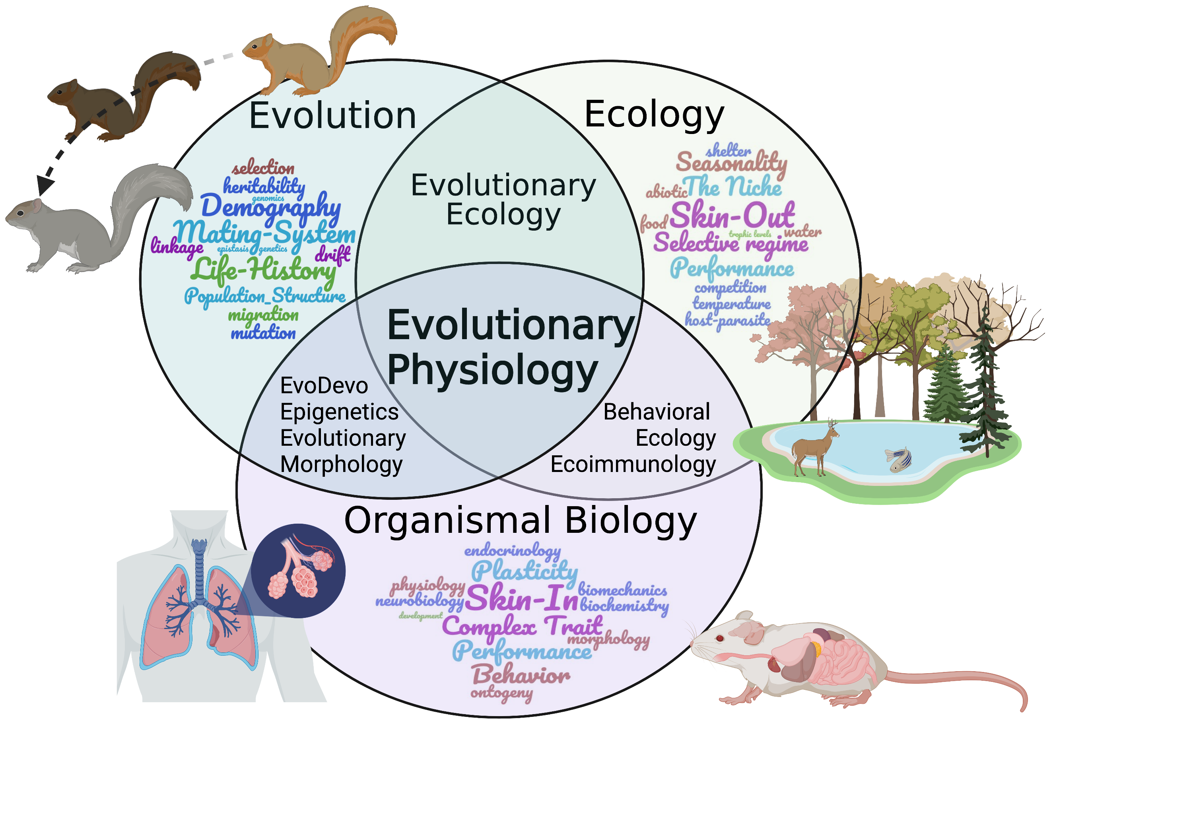
What I Study
Garland, Jr., T., and P. A. Carter. 1994. Evolutionary physiology. Annual Review of Physiology 56:579–621.
Galvan, I., T. S. Schwartz, and T. Garland, Jr. 2022. Evolutionary physiology at 30+: has the promise been fulfilled? BioEssays. In press.
Notes:
Originally modified (heavily) from:
DM.pptx
dena.plemmons@ucr.edu
Houle, D., C. Pélabon, G. P. Wagner, and T. F. Hansen. 2011. Measurement and meaning in biology. The Quarterly Review of Biology 86:3–34.
Deans, A. R., S. E. Lewis, E. Huala, S. S. Anzaldo, M. Ashburner, J. P. Balhoff, D. C. Blackburn, J. A. Blake, J. G. Burleigh, B. Chanet, L. D. Cooper, M. Courtot, S. Csösz, H. Cui, W. Dahdul, S. Das, T. A. Dececchi, A. Dettai, R. Diogo, R. E. Druzinsky, M. Dumontier, N. M. Franz, F. Friedrich, G. V. Gkoutos, M. Haendel, L. J. Harmon, T. F. Hayamizu, Y. He, H. M. Hines, N. Ibrahim, L. M. Jackson, P. Jaiswal, C. James-Zorn, S. Köhler, G. Lecointre, H. Lapp, C. J. Lawrence, N. L. Novère, J. G. Lundberg, J. Macklin, A. R. Mast, P. E. Midford, I. Mikó, C. J. Mungall, A. Oellrich, D. Osumi-Sutherland, H. Parkinson, M. J. Ramírez, S. Richter, P. N. Robinson, A. Ruttenberg, K. S. Schulz, E. Segerdell, K. C. Seltmann, M. J. Sharkey, A. D. Smith, B. Smith, C. D. Specht, R. B. Squires, R. W. Thacker, A. Thessen, J. Fernandez-Triana, M. Vihinen, P. D. Vize, L. Vogt, C. E. Wall, R. L. Walls, M. Westerfeld, R. A. Wharton, C. S. Wirkner, J. B. Woolley, M. J. Yoder, A. M. Zorn, and P. Mabee. 2015. Finding our way through phenotypes. PLOS Biology 13:e1002033.

Slide 3
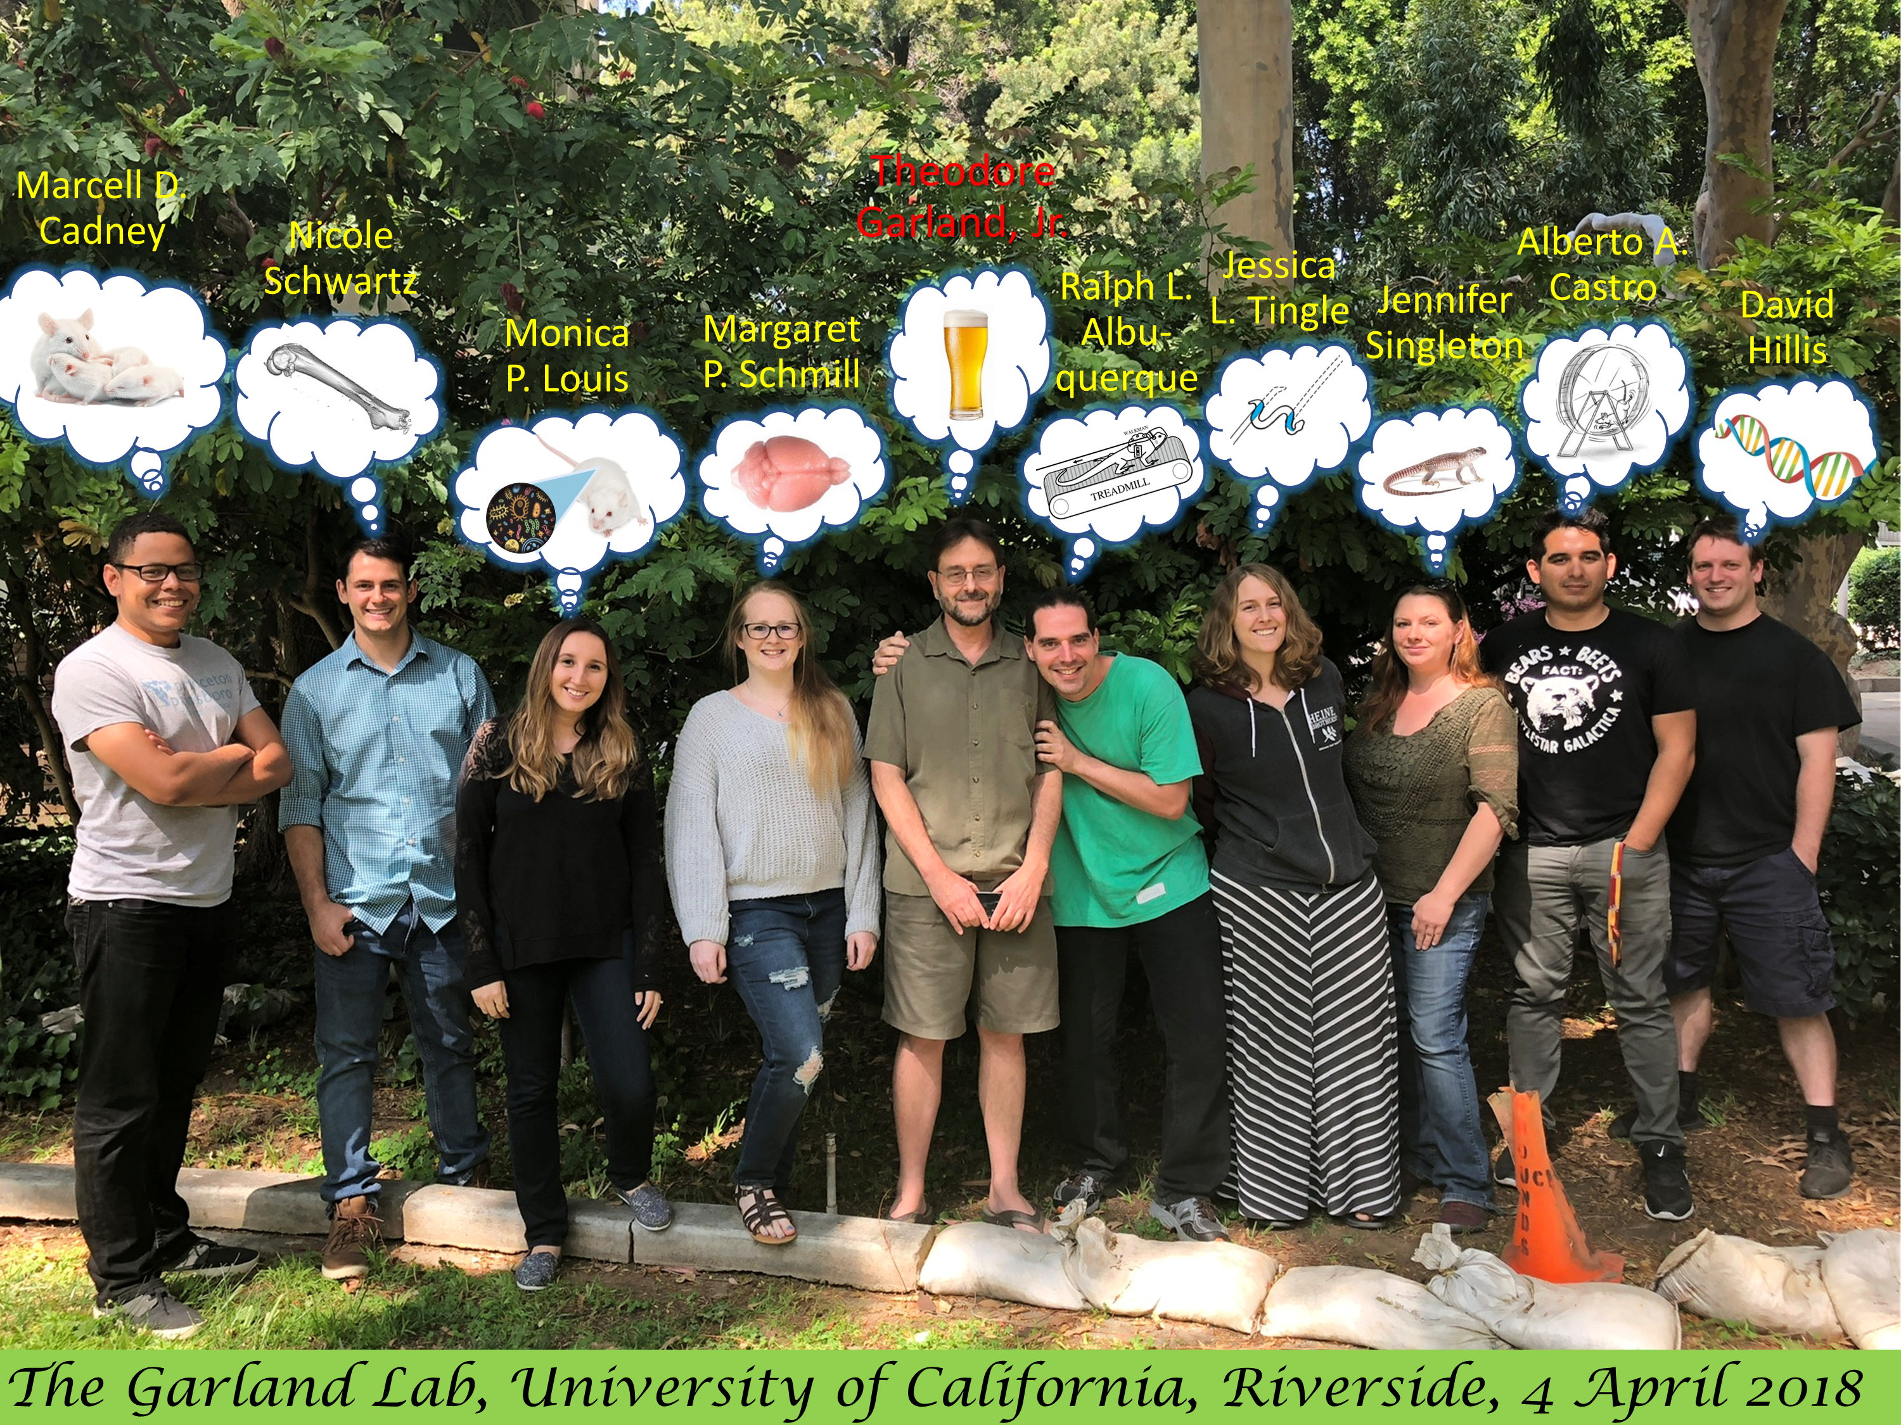
Notes:
Originally modified (heavily) from:
DM.pptx
dena.plemmons@ucr.edu
Houle, D., C. Pélabon, G. P. Wagner, and T. F. Hansen. 2011. Measurement and meaning in biology. The Quarterly Review of Biology 86:3–34.
Deans, A. R., S. E. Lewis, E. Huala, S. S. Anzaldo, M. Ashburner, J. P. Balhoff, D. C. Blackburn, J. A. Blake, J. G. Burleigh, B. Chanet, L. D. Cooper, M. Courtot, S. Csösz, H. Cui, W. Dahdul, S. Das, T. A. Dececchi, A. Dettai, R. Diogo, R. E. Druzinsky, M. Dumontier, N. M. Franz, F. Friedrich, G. V. Gkoutos, M. Haendel, L. J. Harmon, T. F. Hayamizu, Y. He, H. M. Hines, N. Ibrahim, L. M. Jackson, P. Jaiswal, C. James-Zorn, S. Köhler, G. Lecointre, H. Lapp, C. J. Lawrence, N. L. Novère, J. G. Lundberg, J. Macklin, A. R. Mast, P. E. Midford, I. Mikó, C. J. Mungall, A. Oellrich, D. Osumi-Sutherland, H. Parkinson, M. J. Ramírez, S. Richter, P. N. Robinson, A. Ruttenberg, K. S. Schulz, E. Segerdell, K. C. Seltmann, M. J. Sharkey, A. D. Smith, B. Smith, C. D. Specht, R. B. Squires, R. W. Thacker, A. Thessen, J. Fernandez-Triana, M. Vihinen, P. D. Vize, L. Vogt, C. E. Wall, R. L. Walls, M. Westerfeld, R. A. Wharton, C. S. Wirkner, J. B. Woolley, M. J. Yoder, A. M. Zorn, and P. Mabee. 2015. Finding our way through phenotypes. PLOS Biology 13:e1002033.

Slide 4
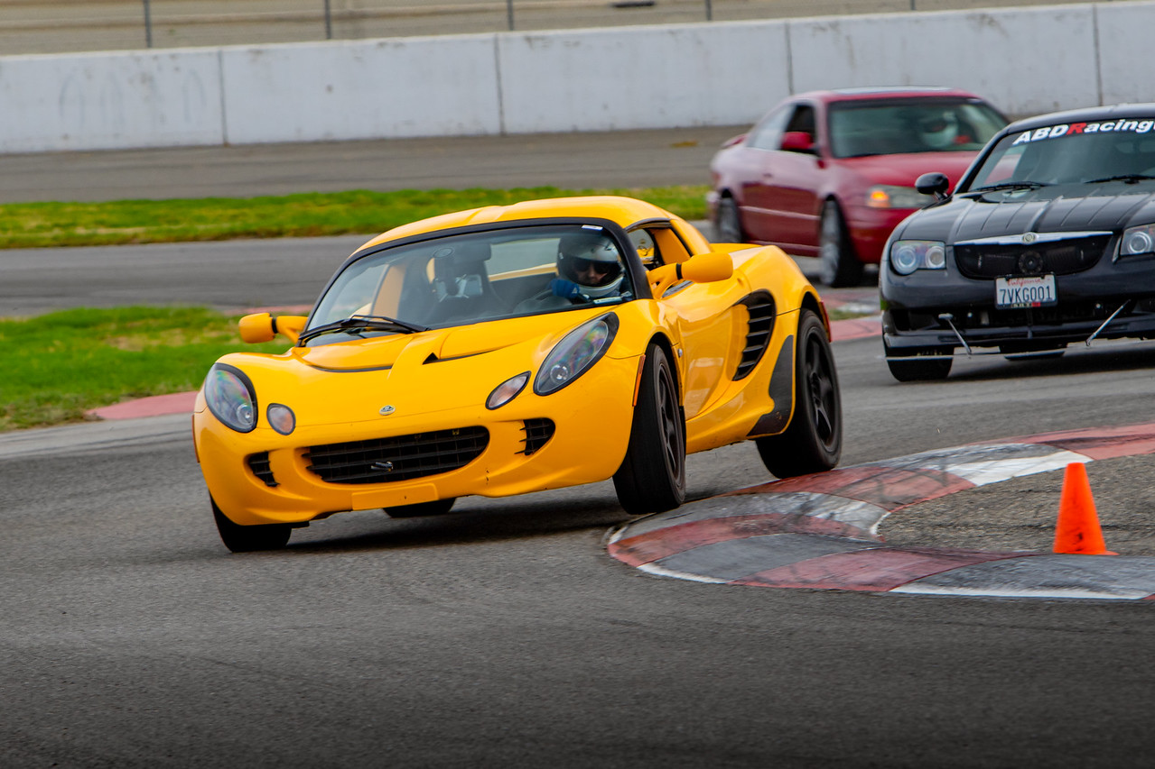
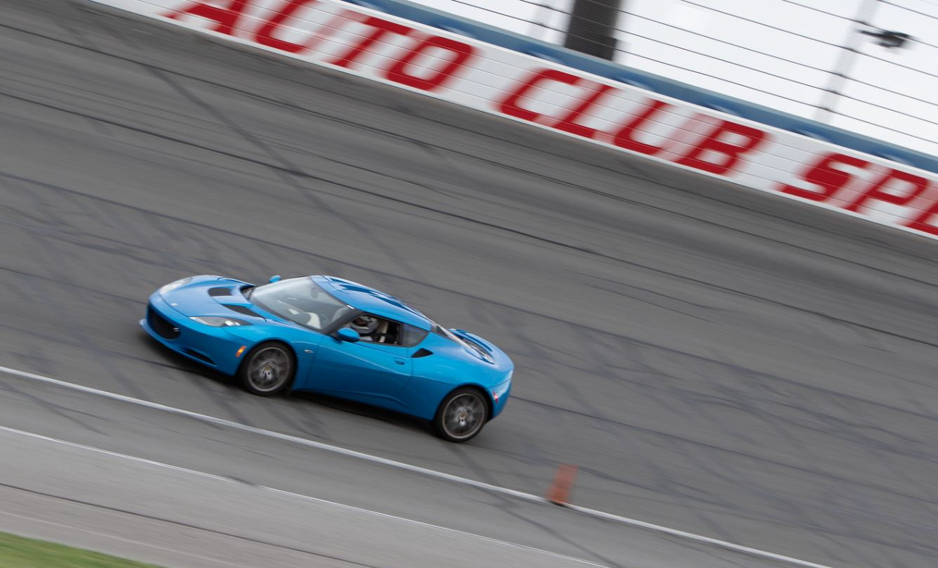
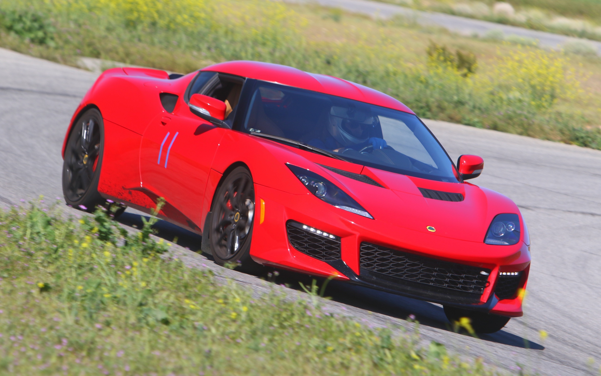
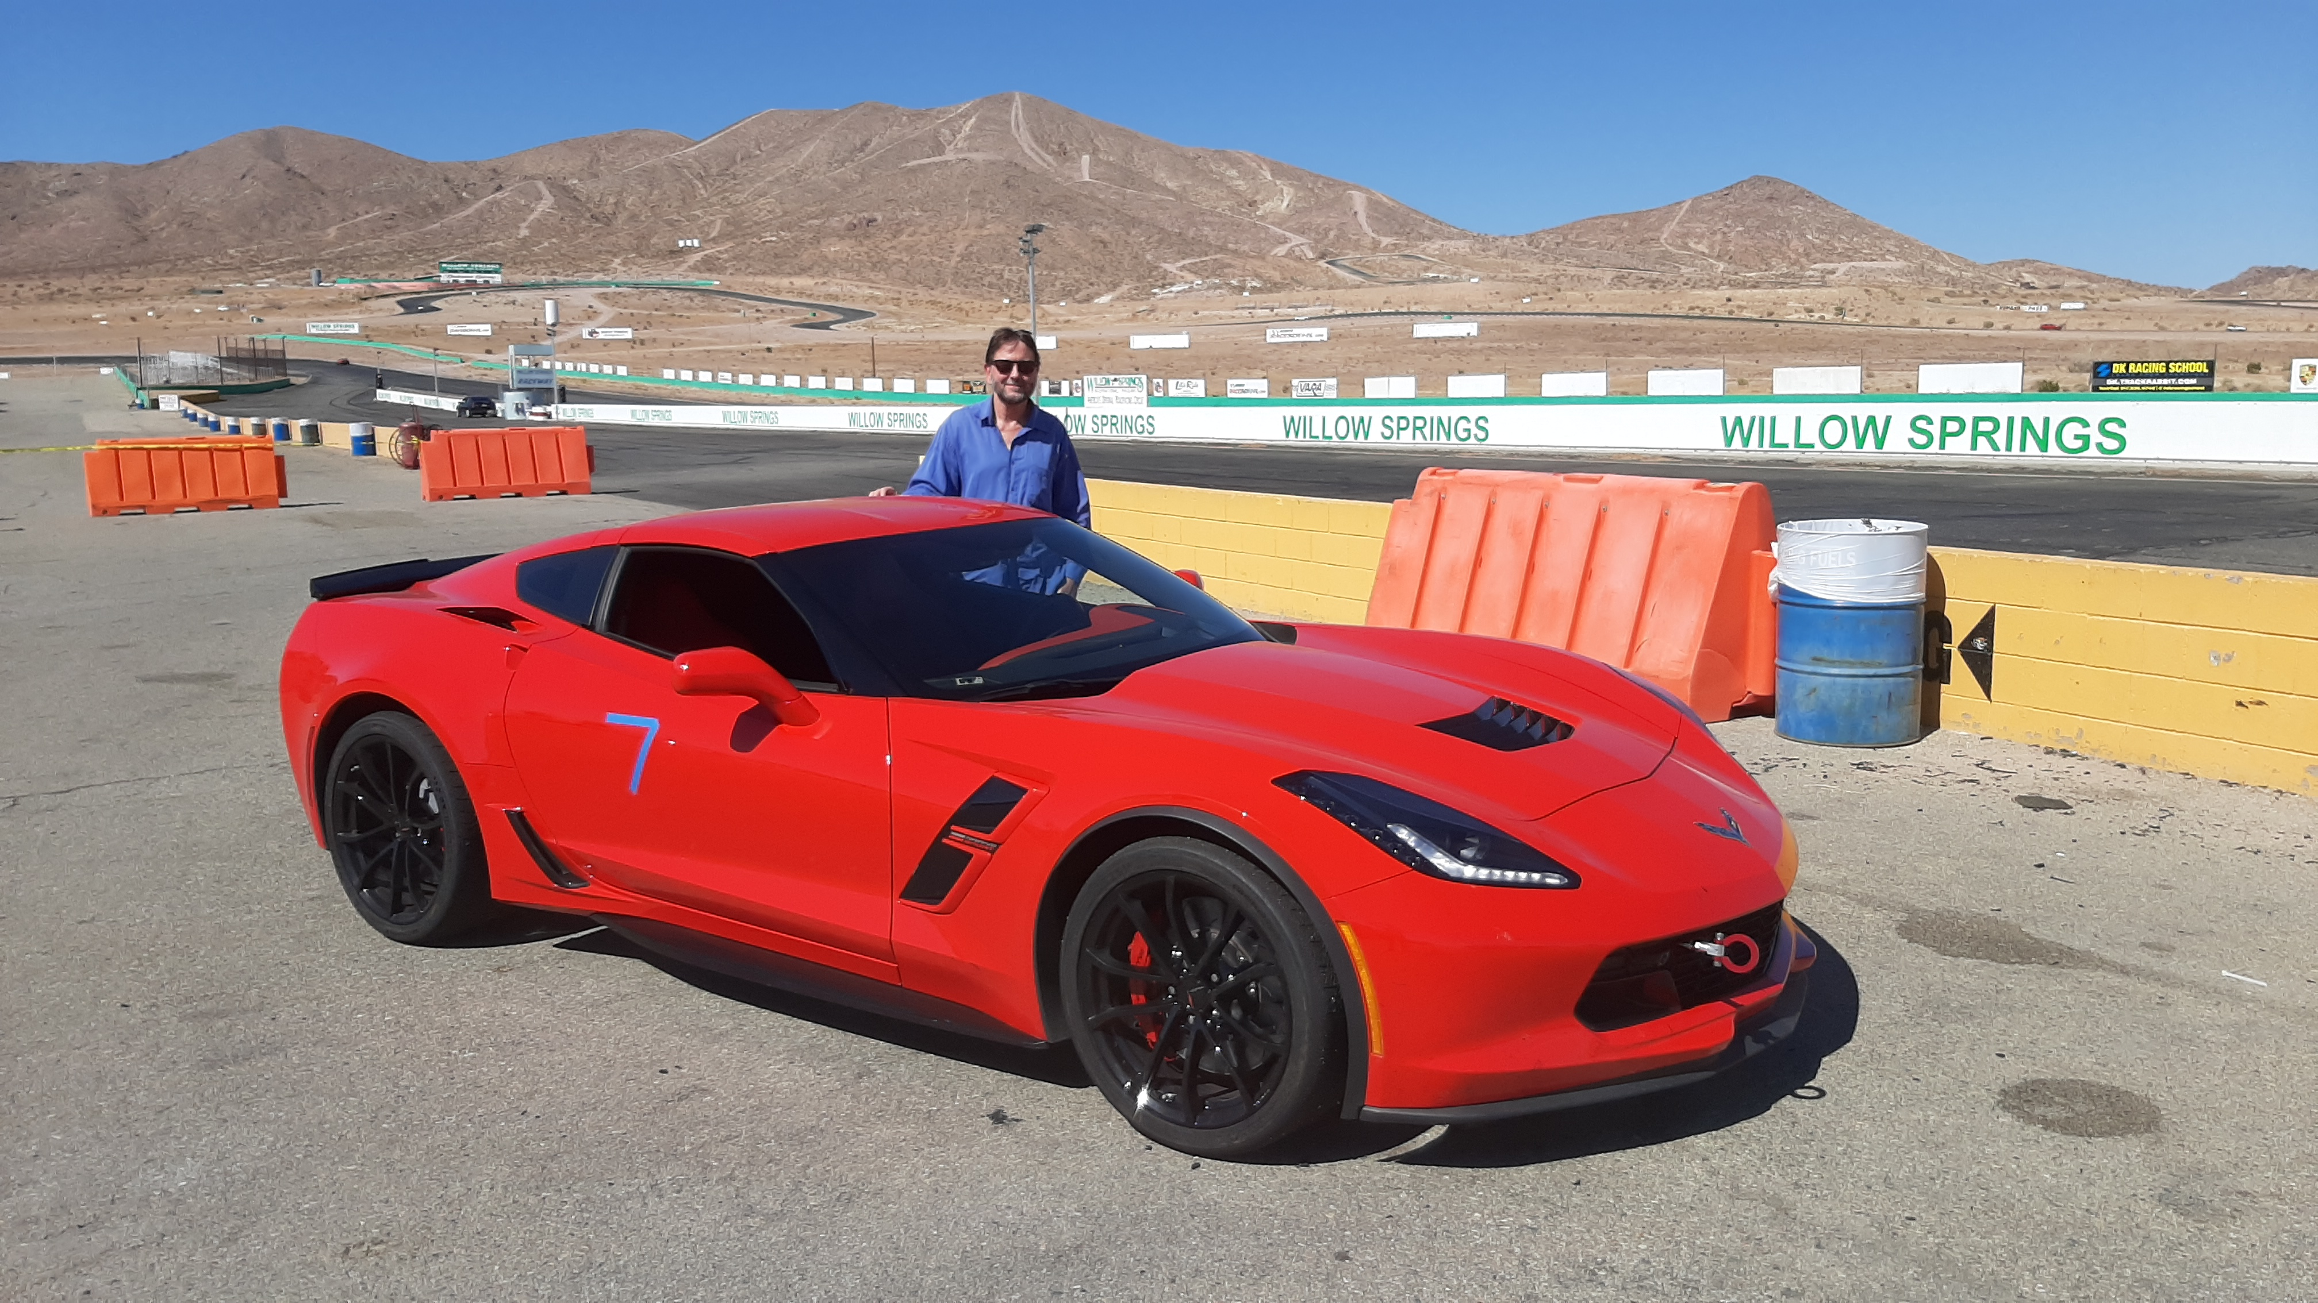
What I Do for Fun
Notes:
Originally modified (heavily) from:
DM.pptx
dena.plemmons@ucr.edu
Houle, D., C. Pélabon, G. P. Wagner, and T. F. Hansen. 2011. Measurement and meaning in biology. The Quarterly Review of Biology 86:3–34.
Deans, A. R., S. E. Lewis, E. Huala, S. S. Anzaldo, M. Ashburner, J. P. Balhoff, D. C. Blackburn, J. A. Blake, J. G. Burleigh, B. Chanet, L. D. Cooper, M. Courtot, S. Csösz, H. Cui, W. Dahdul, S. Das, T. A. Dececchi, A. Dettai, R. Diogo, R. E. Druzinsky, M. Dumontier, N. M. Franz, F. Friedrich, G. V. Gkoutos, M. Haendel, L. J. Harmon, T. F. Hayamizu, Y. He, H. M. Hines, N. Ibrahim, L. M. Jackson, P. Jaiswal, C. James-Zorn, S. Köhler, G. Lecointre, H. Lapp, C. J. Lawrence, N. L. Novère, J. G. Lundberg, J. Macklin, A. R. Mast, P. E. Midford, I. Mikó, C. J. Mungall, A. Oellrich, D. Osumi-Sutherland, H. Parkinson, M. J. Ramírez, S. Richter, P. N. Robinson, A. Ruttenberg, K. S. Schulz, E. Segerdell, K. C. Seltmann, M. J. Sharkey, A. D. Smith, B. Smith, C. D. Specht, R. B. Squires, R. W. Thacker, A. Thessen, J. Fernandez-Triana, M. Vihinen, P. D. Vize, L. Vogt, C. E. Wall, R. L. Walls, M. Westerfeld, R. A. Wharton, C. S. Wirkner, J. B. Woolley, M. J. Yoder, A. M. Zorn, and P. Mabee. 2015. Finding our way through phenotypes. PLOS Biology 13:e1002033.

Slide 5
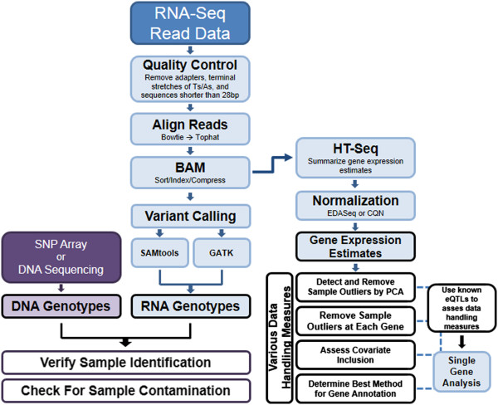
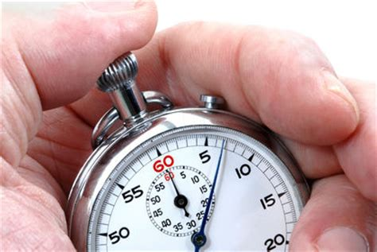
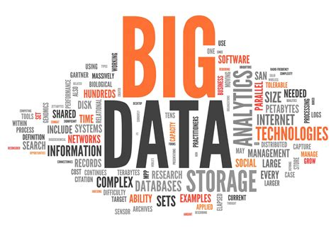
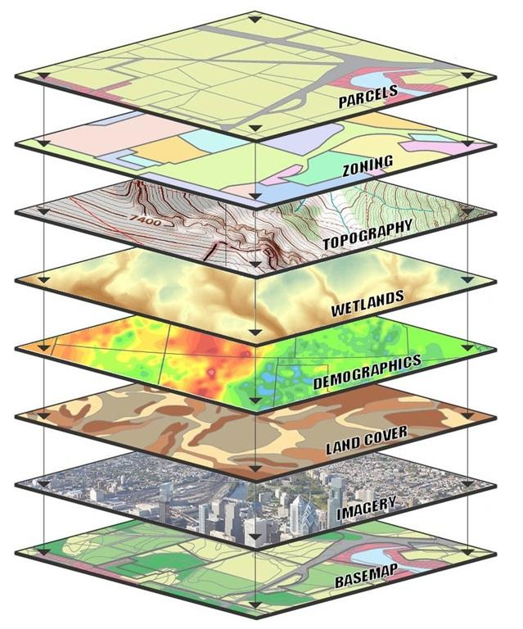
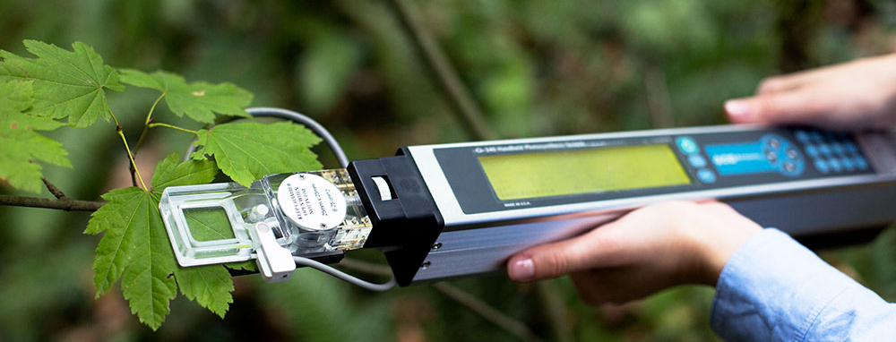
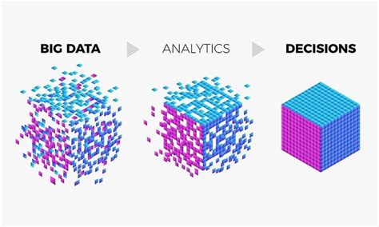
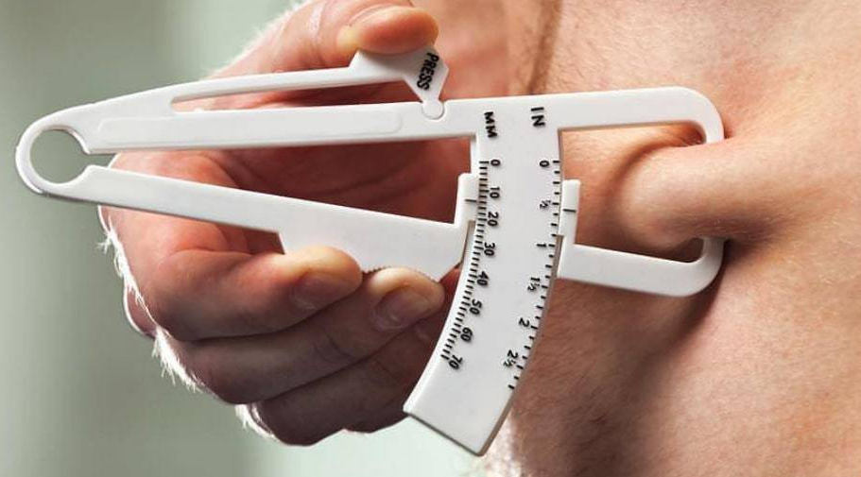
Data Management & Related Topics
Theodore Garland, Jr.
EEOB 400
3 Nov. 2021
Notes:
Originally modified (heavily) from:
DM.pptx
dena.plemmons@ucr.edu
Houle, D., C. Pélabon, G. P. Wagner, and T. F. Hansen. 2011. Measurement and meaning in biology. The Quarterly Review of Biology 86:3–34.
Deans, A. R., S. E. Lewis, E. Huala, S. S. Anzaldo, M. Ashburner, J. P. Balhoff, D. C. Blackburn, J. A. Blake, J. G. Burleigh, B. Chanet, L. D. Cooper, M. Courtot, S. Csösz, H. Cui, W. Dahdul, S. Das, T. A. Dececchi, A. Dettai, R. Diogo, R. E. Druzinsky, M. Dumontier, N. M. Franz, F. Friedrich, G. V. Gkoutos, M. Haendel, L. J. Harmon, T. F. Hayamizu, Y. He, H. M. Hines, N. Ibrahim, L. M. Jackson, P. Jaiswal, C. James-Zorn, S. Köhler, G. Lecointre, H. Lapp, C. J. Lawrence, N. L. Novère, J. G. Lundberg, J. Macklin, A. R. Mast, P. E. Midford, I. Mikó, C. J. Mungall, A. Oellrich, D. Osumi-Sutherland, H. Parkinson, M. J. Ramírez, S. Richter, P. N. Robinson, A. Ruttenberg, K. S. Schulz, E. Segerdell, K. C. Seltmann, M. J. Sharkey, A. D. Smith, B. Smith, C. D. Specht, R. B. Squires, R. W. Thacker, A. Thessen, J. Fernandez-Triana, M. Vihinen, P. D. Vize, L. Vogt, C. E. Wall, R. L. Walls, M. Westerfeld, R. A. Wharton, C. S. Wirkner, J. B. Woolley, M. J. Yoder, A. M. Zorn, and P. Mabee. 2015. Finding our way through phenotypes. PLOS Biology 13:e1002033.

Slide 6
Why Think About This?
"False facts are highly injurious to the progress of science, for they often long endure; but false views, if supported by some evidence, do little harm, as every one takes a salutary pleasure in proving their falseness."
Darwin, C. 1871. The descent of man and selection in relation to sex. Murray, London.
Training in this sort of thing is becoming required by funding agencies. dena.plemmons@ucr.edu in the graduate division gives talks like this for some graduate programs; a bunch of my slides are modified from hers.

Slide 7
Personal Horror Stories
Raw data thrown away just before I requested them
Unproofed data just before dissertation due
Apparently same data file with different dates/times
Computer & backup hard drive stolen from Spieth Hall
Data books & computers stolen from parked cars
Different versions of R giving different answers

Slide 8
The Lifecycle of Data (Data Management Domains)

Slide 9
The Lifecycle of Data
Plan
Notes:
Methods
Logistics
Funding

Slide 10
The Lifecycle of Data
Plan
Collect
Notes:
How do you measure?

Slide 11
The Lifecycle of Data
Plan
Collect
Preserve
Notes:
How do you secure and archive the raw data once they are collected?

Slide 12
The Lifecycle of Data
Plan
Collect
Preserve
Process
Notes:
Turning raw data (e.g., GPS coordinates, RNA-seq reads) into something you can use.
Quality control.

Slide 13
The Lifecycle of Data
Plan
Collect
Preserve
Process
Analyze
Notes:
Graphs, Reality checks, Statistics

Slide 14
The Lifecycle of Data
Plan
Collect
Preserve
Process
Analyze
Publish
Notes:
How to present?
Figures versus Tables?
Supplementary materials?
What journal?

Slide 15
The Lifecycle of Data
Plan
Collect
Preserve
Process
Analyze
The End?
Publish
Notes:
"Is that all there is, my friend?"

Slide 16
The Lifecycle of Data
Plan
Collect
Preserve
Process
Analyze
Publish
Share

Slide 17
The Lifecycle of Data
Plan
Collect
Preserve
Process
Analyze
Publish
Share
Re-use

Slide 18
The Lifecycle of Data
Plan
Collect
Preserve
Process
Analyze
New Analyses
Add Other Data
Meta-analyses
Publish
Share
Re-use

Slide 19
Collection/Production
What’s the purpose of the research?
What are the data? How and in what format will the data be collected? Numerical data, images, text sequences, simulation results?
How much data will be generated?
Who collects the data? How are they trained? How is their accuracy verified?
dena.plemmons@ucr.edu
Notes:
Do you calibrate a balance before you use it?
I pipette?

Slide 20
Collection/Production
What instruments might be used in data collection/production?
What are plans for calibration, etc., and documentation of same?
Do you understand the theory/chemistry/physics inside the machine?
dena.plemmons@ucr.edu
Notes:
Do you calibrate a balance before you use it?
I pipette?

Slide 21
Collection/Production
Does you lab have a set of Standard Operating Protocols?
How long will the data be collected and how often will it change?
If you find errors at a later stage, how will you correct them in the original source files? Are the originals locked?
Are you using data that someone else produced? If so, where is it from and can you trust it?
Who is responsible for managing the data? Who will ensure that the data management plan is carried out?
dena.plemmons@ucr.edu

Slide 22
What's Your Data Pipeline?
https://www.informatica.com/resources/articles/data-pipeline.html
"Data pipelines move data from one source to another so it can be stored, used for analytics, or combined with other data. … more specifically, a data pipeline is an end-to-end process to ingest, process, prepare, transform and enrich structured, unstructured, and semi-structured data in a governed manner."
dena.plemmons@ucr.edu
Notes:
This is becoming big in business.
Lots of companies will do this for you:
https://www.stitchdata.com/resources/what-is-data-pipeline/
Maybe you will get a job doing this someday …
https://www.qlik.com/us/data-integration/data-pipeline

Slide 23
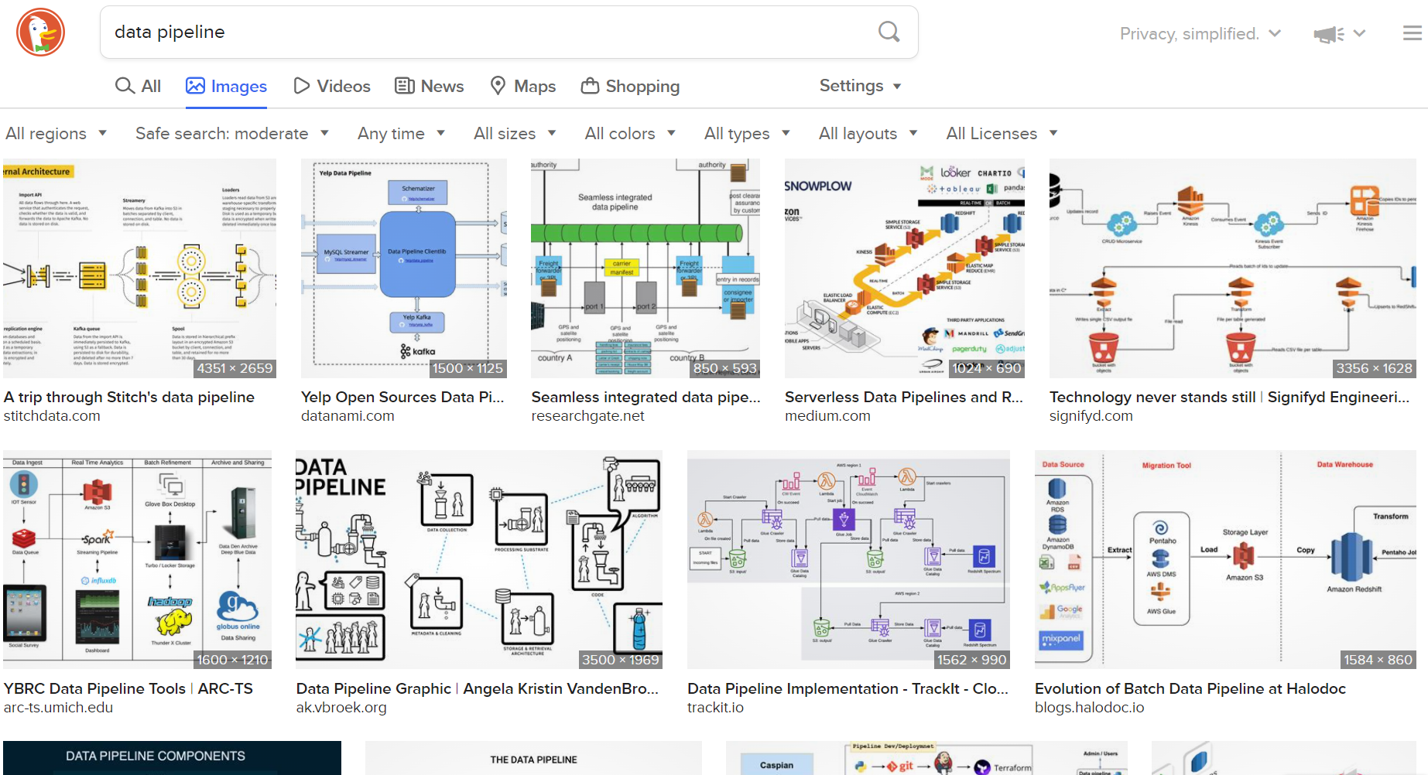
What's Your Data Pipeline?
dena.plemmons@ucr.edu
Notes:
https://www.qlik.com/us/data-integration/data-pipeline

Slide 24
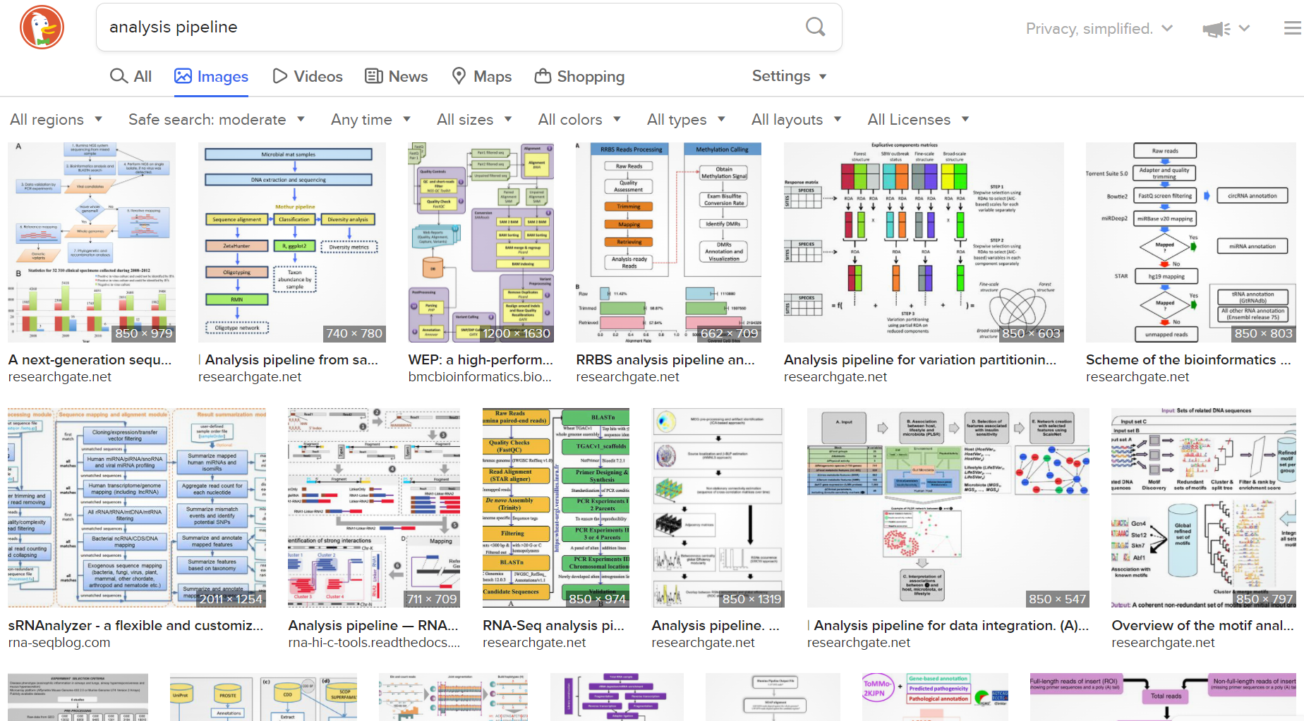
What's Your Analysis Pipeline?
dena.plemmons@ucr.edu
Notes:
Especially prominent in molecular analyses of sequencing, metagenomic, gene expression data.

Slide 25
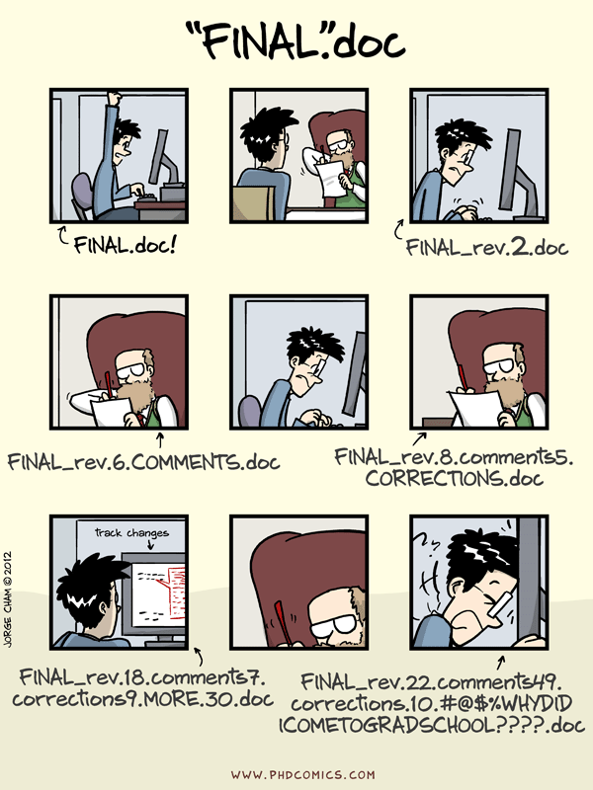
Preserving/Archiving Data
Version control and naming of data files?
Sequential versus simultaneous?
dena.plemmons@ucr.edu

Slide 26
Preserving/Archiving Data
How will you archive the data? Will you be storing it in an archive or repository for long-term access? If not, how will you preserve access to the data?
Is a discipline-specific repository available (e.g., GenBank)? How will you prepare data for preservation or data sharing? Will the data need to be anonymized or converted to more stable file formats?
dena.plemmons@ucr.edu

Slide 27
Preserving/Archiving Data
Are software or tools needed to use the data? Will these be archived?
How long should the data be retained? 3-5 years, 10 years, or forever?
dena.plemmons@ucr.edu

Slide 28
Processing/Documentation/ Organization/Storage
What, if any, are your quality control procedures?
How will you process the data? [eliminating noise, combining data from multiple sources, format conversion]
What documentation will you be creating to make the data understandable by other researchers?
Are you using metadata that is standard to your field? How will the metadata be managed and stored?
dena.plemmons@ucr.edu

Slide 29
Analysis & Interpretation of Data
Pre-registration [the practice of registering a scientific study before it is conducted]?
Standard analytic approaches for your field?
Statistical methods and software to be used?
Can you verify that the results from a given statistical package are correct? (e.g., verify worked examples)
Standard interpretations?
dena.plemmons@ucr.edu

Slide 30
Publishing Data
Does the journal allow "full" presentation of data and appropriate analyses? Limit number of display items?
What about the number of significant figures on P-values, which would be needed for correcting for multiple comparisons or meta-analyses?
Choice of journal relative to their data submission procedures. Raw data? Processed data?
Code to perform statistical analyses and make graphs?
Proprietary software created to analyze the data?
How do they archive the data? Their own website versus a standard repository (e.g., GenBank)? Any cost to the author?
dena.plemmons@ucr.edu

Slide 31
Accessing/Sharing/Re-use
Who has the right/responsibility to manage this data? PI, students, institution, funding agency?
What data will be shared, when, and how?
Does sharing the data raise privacy, ethical, or confidentiality concerns? Humans subjects, endangered species? Do you have a plan to protect or anonymize data, if needed?
Who holds intellectual property rights for the data and other information created by the project? Will any copyrighted or licensed material be used? Do you have permission to use/disseminate this material?
dena.plemmons@ucr.edu

Slide 32
Accessing/Sharing/Re-use
Are there any patent- or technology-licensing-related restrictions on data sharing associated with this grant?
Will this research be published in a journal that requires the underlying data to accompany articles?
Will there be any embargoes on the data?
Will you permit re-use, redistribution, or the creation of new tools, services, data sets, or products (derivatives)? Will commercial use be allowed?
dena.plemmons@ucr.edu

